Slide 1


CS44 Data Communications

Slide 2



TRANSMISSION IMPAIRMENT
Attenuation
Distortion
Noise
DATA RATE LIMITS
Noiseless Channel: Nyquist Bit Rate
Noisy Channel: Shannon Capacity
Using Both Limits
PERFORMANCE
Bandwidth
Throughput
Latency (Delay)
Bandwidth-Delay Product
Jitter

Slide 3













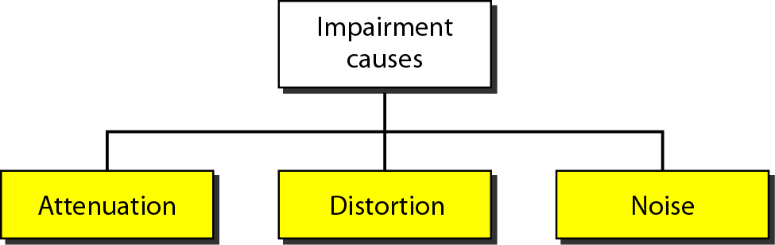

Signals travel through transmission media→ not perfect
Imperfection → causes signal impairment
Signal at the beginning of the medium is not the same as the signal at the end of the medium
What is sent is not what is received
Three causes of impairment
Attenuation
Distortion
Noise

Slide 4

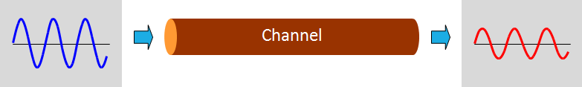
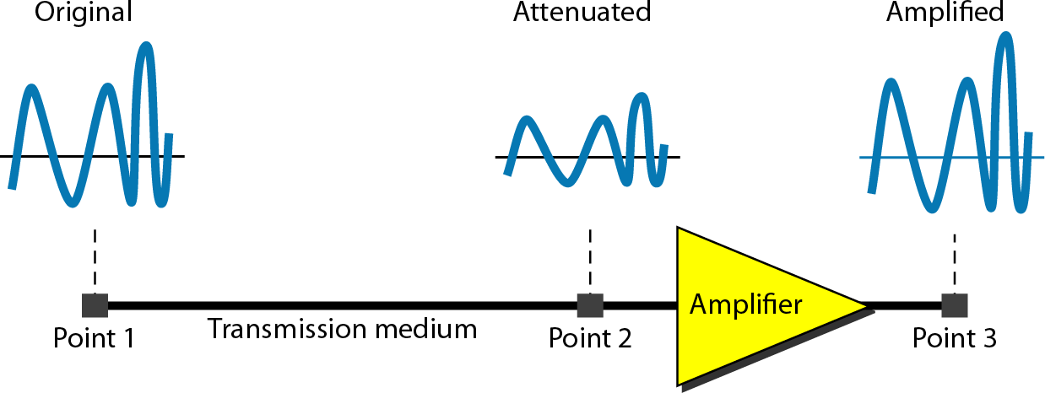
Attenuation means a loss of energy
When a signal ( simple or composite ) travels through a
medium, it loses some of its energy in overcoming the resistance of the medium
Why wire carrying electric signals gets warm after a while?
Some of the electrical energy in the signal is converted to heat
To compensate for this loss, amplifiers are used to amplify the signal
The higher the frequency, the higher the attenuation

Slide 5

How to show that a signal has lost or gained strength?
engineers use the unit of the decibel
The decibel (dB) measures the relative strengths of two signals or one signal at two different points
Positive dB 🠦 signal is amplified (gains strength)
Negative dB 🠦 signal is attenuated (loses strength)
Decibel → defined in terms of voltage or power
because power is proportional to the square of the voltage

Slide 6




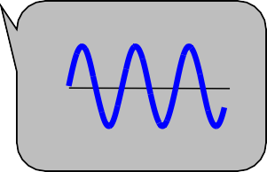
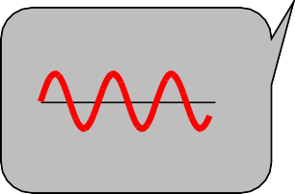
Attenuation - Relative Signal Strength
Measured in Decibel (dB)
Point 1 Point 2
dB in terms of | Formula | variables
Power | dB = 10 log₁₀ (P2/P1) | P1 and P2 → powers of a signal at points 1 and 2, respectively
voltage | dB = 20 log₁₀ (V2/V1) | V1 and V2 → voltage of a signal at points 1 and 2, respectively

Slide 7


Attenuation Example 1
Suppose a signal travels through a transmission medium and its power is reduced to one-half
Means that P2 is (1/2)P1
In this case, the attenuation (loss of power) can be calculated as
A loss of 3 dB (–3 dB) is equivalent to losing one-half the power

Slide 8



Attenuation Example 2
A signal travels through an amplifier, and its power is increased 10 times
Means that P2 = 10P1
In this case, the amplification (gain of power) can be calculated as

Slide 9

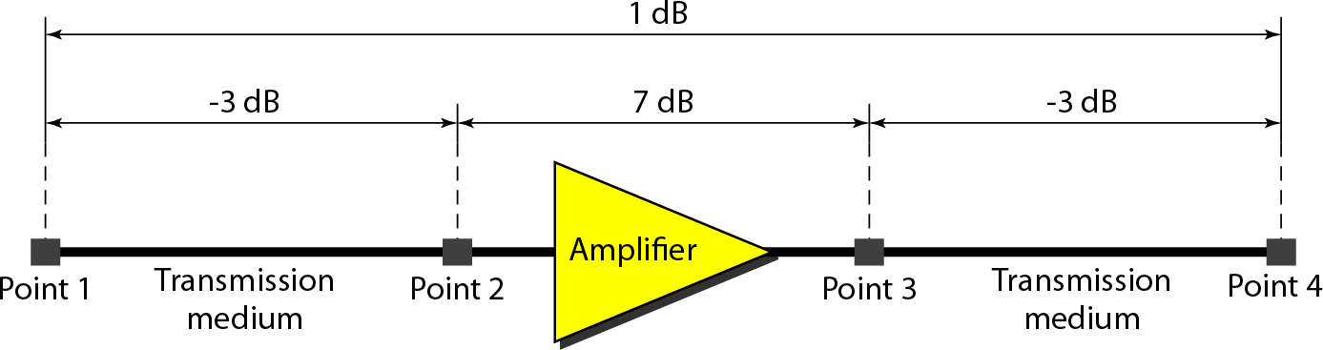

Attenuation Example 3
One reason that engineers use the decibel to measure the
changes in the strength of a signal → decibel numbers can be
added (or subtracted) when we are measuring several points (cascading) instead of just two
A signal travels from point 1 to point 4
The signal is attenuated by the time it reaches point 2
Between points 2 and 3, the signal is amplified
Again, between points 3 and 4, the signal is attenuated
In this case, the decibel value can be calculated as
The signal has gained in power.

Slide 10






Attenuation - Link Budget
Accounting of all gains and losses of signal power throughout
the signal's path
𝑅𝑥 𝑃𝑜𝑤𝑒𝑟 𝑑𝐵 = 𝑇𝑥 𝑃𝑜𝑤𝑒𝑟 𝑑𝐵 + 𝐺𝑎𝑖𝑛𝑠 𝑑𝐵 − 𝐿𝑜𝑠𝑠𝑒𝑠 (𝑑𝐵)
Tx Power Rx Power
Cable loss
Cable
Sender
Receiver
Tx antenna gain
Rx antenna gain
path loss
Tx amp
gain
Rx amp
gain
Tx Power
Rx Power
Sender
TX
Amplifier
RX
Amplifier
Receiver

Slide 11

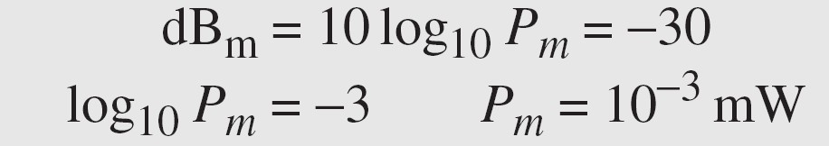
Attenuation Example 4
Sometimes the decibel is used to measure signal power in milliwatts
referred as dB_{m}
calculated as dB_{m} = 10 log₁₀ P_{m}
where P_{m} is the power in milliwatts
Calculate the power of a signal with dB_{m} = −30
We can calculate the power in the signal as

Slide 12

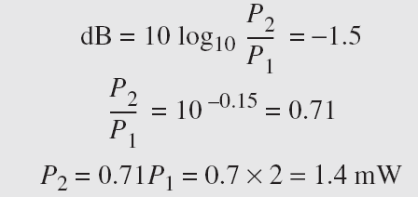
Attenuation Example 5
The loss in a cable is usually defined in decibels per kilometer (dB/km)
If the signal at the beginning of a cable with −0.3 dB/km has a power of 2 mW, what is the power of the signal at 5 km?
Solution: The loss in the cable in decibels is 5 × (−0.3) =
−1.5 dB. We can calculate the power as

Slide 13

Distortion
Distortion means that the signal changes its form or shape
occur in a composite signal made of different frequencies.
Each signal component has its own propagation speed through a medium
its own delay in arriving at the final destination
Propagation velocity varies with frequency

Slide 14

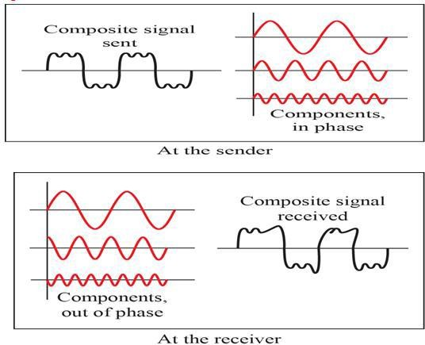
Distortion …
If the delay is not exactly the same as the period duration, it may create a
difference in phase
Signal components at the receiver have phases different from what they had at the sender
The shape of the composite signal is therefore not the same

Slide 15

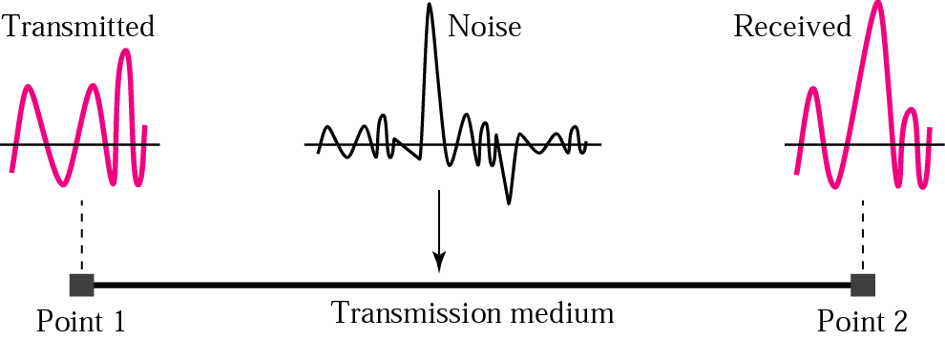


Noise
Noise ⇨ Undesirable signals added between the transmitter and the receiver
may corrupt the signal
Types of noise | Description
thermal noise | random motion of electrons in a wire creates an extra signal not originally sent by the transmitter
induced noise | comes from sources such as motors and appliances Devices act as a sending antenna Transmission medium acts as the receiving antenna
crosstalk | effect of one wire on the other One wire acts as a sending antenna ^{Wire 1} Other wire as the receiving antenna Wire 2
impulse noise | a spike (a signal with high energy in a very short time) that comes from power lines, lightning, and so on

Slide 16




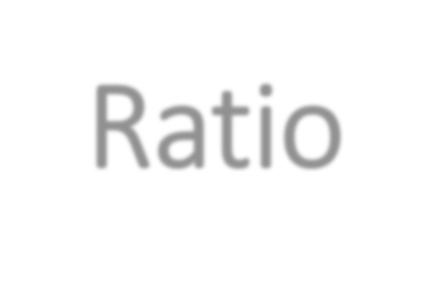
Noise : Signal-to-Noise Ratio
SNR is the ratio of what is wanted (signal) to what is not wanted (noise).
A measurement of signal reception's quality
often described in decibel units, SNR_{dB}
SNR_{dB} = 10 log₁₀ SNR
high SNR means the signal is less corrupted by noise.
Low SNR means the signal is more corrupted by noise

Slide 17

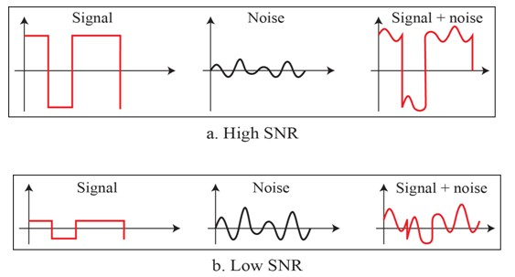


Noise : Signal-to-Noise Ratio
The power of a signal is 10 mW and the power of the noise is 1 μW; what are the values of SNR and SNR_{dB} ?
SNR = ^{10000μw} = 10000μw SNR
= 10
log log
10
4
10000= 10
= 40
1μw
dB
10 10

Slide 18
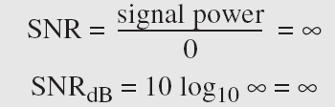
Noise : Signal-to-Noise Ratio
The values of SNR and SNR_{dB} for a noiseless channel are
We can never achieve this ratio in real life; it is an ideal

Slide 19

Data Rate Limits
Data rate: How fast we can send data in bits per second, over a channel?
Data rate depends on three factors:
The bandwidth available
The level of the signals we use
The quality of the channel (the level of noise)
Two theoretical formulas were developed to calculate the data rate:
Nyquist for a noiseless channel
Shannon for a noisy channel.

Slide 20



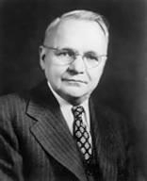


Noiseless Channel: Nyquist Bit Rate
Nyquist bit rate formula defines the theoretical maximum bit rate
Bit Rate = 2 × Bandwidth × log₂L
Bandwidth is the bandwidth of the channel
L is the number of signal levels used to represent data
BitRate is the bit rate in bits per second.
Harry Nyquist
(1889-1976)
theoretically , given a specific bandwidth, any bit rate can be calculated by increasing the number of signal levels
Practically there is a limit
Increase in the number of signal levels, a burden on the receiver is imposed
If the number of levels in a signal is just 2, the receiver can easily distinguish between a 0 and a 1
If the level of a signal is 64, the receiver must be very sophisticated to distinguish between 64 different levels.
increasing the levels of a signal reduces the reliability of the system.

Slide 21
Noiseless Channel: Nyquist Bit Rate
Does the Nyquist theorem bit rate agree with the intuitive bit rate described in baseband transmission?
They match when we have only two levels.
In baseband transmission, the bit rate is 2 times the bandwidth if
we use only the first harmonic in the worst case
However, the Nyquist formula is more general and can be applied
to baseband transmission and modulation
It can be applied when we have two or more levels of signals.

Slide 22
Noiseless Channel: Nyquist Bit Rate
Consider a noiseless channel with a bandwidth of 3000 Hz transmitting a signal with two signal levels.
The maximum bit rate can be calculated as
Consider the same noiseless channel transmitting a signal with four signal levels (for each level, we send 2 bits).
The maximum bit rate can be calculated as

Slide 23

Noiseless Channel: Nyquist Bit Rate
We need to send 265 kbps over a noiseless channel with a bandwidth of 20 kHz. How many signal levels do we need?
use the Nyquist formula as shown:
Since this result (L) is not a power of 2, we need to either increase the number of levels or reduce the bit rate
If we have 128 levels, the bit rate is 280 kbps
If we have 64 levels, the bit rate is 240 kbps

Slide 24





Noisy Channel: Shannon's Capacity
In reality, the channel is always noisy.
Claude Shannon introduced a formula
determine the theoretical highest data rate for a
noisy channel: Shannon's Capacity
Capacity = Bandwidth × log₂(1+SNR)
bandwidth is the bandwidth of the channel (Hz)
SNR is the signal-to-noise ratio
capacity is the capacity of the channel in bits per second
Claude Elwood Shannon
(1916-2001)
No indication of the signal level - means that no matter how many levels we have, we cannot achieve a data rate higher than the capacity of the channel
It is a characteristic of the channel, not the method of transmission

Slide 25



Example 1 – Shannon's Capacity
Consider an extremely noisy channel in which the value of the signal-to-noise ratio is almost zero.
the noise is so strong that the signal is faint.
For this channel the capacity C is calculated as
This means that the capacity of this channel is zero regardless of the bandwidth
We cannot receive any data through this channel

Slide 26

Example 2 – Shannon's Capacity
We can calculate the theoretical highest bit rate of a regular telephone line. A telephone line normally has a bandwidth of 3000. The signal-to-noise ratio is usually 3162. For this channel the capacity is calculated as
This means that the highest bit rate for a telephone line is 34.860 kbps
If we want to send data faster than this, we can either increase the bandwidth of the line or improve the signal-to-noise ratio.

Slide 27

Example 3 – Shannon's Capacity
The signal-to-noise ratio is often given in decibels. Assume that SNR_{dB} = 36 and the channel bandwidth is 2 MHz. The theoretical channel capacity can be calculated as

Slide 28



Example 4 – Shannon's Capacity
For practical purposes, when the SNR is very high, we can assume that SNR + 1 is almost the same as SNR. In these cases, the theoretical channel capacity can be simplified to
For example, we can calculate the theoretical capacity of the previous example as

Slide 29

Using Both Limits
In practice, both methods used to find the limits and signal levels
Example 1: We have a channel with a 1-MHz bandwidth. The SNR for this channel is 63. What are the appropriate bit rate and signal level?
Use the Shannon formula to find the upper limit.
The Shannon formula gives us 6 Mbps, the upper limit
For better performance we choose something lower, 4 Mbps, for example.
Use the Nyquist formula to find the number of signal levels
The Shannon capacity gives us the upper limit; the Nyquist formula tells us
how many signal levels we need.

Slide 30





Network Performance
important issue in networking → performance of the network
Performance parameters:
Bandwidth
Analog – Hertz
Digital – Bits per second (bps)
Throughput
Actual data rate
Latency (delay)
Time it takes for an entire message to completely arrive at the destination

Slide 31

Bandwidth
used in two different contexts with two different measuring values:
bandwidth in hertz
range of frequencies contained in a composite signal or the range of frequencies a channel can pass
Ex. bandwidth of a subscriber telephone line is 4 kHz
bandwidth in bits per second
number of bits per second that a channel, a link, or even a network can transmit
Ex. bandwidth of a Fast Ethernet network (or the links in this network) is a maximum of 100 Mbps - means that this network can send 100 Mbps.
relationship between the bandwidth in hertz and bandwidth in bits per second
increase in bandwidth in hertz means an increase in bandwidth in bits per
second
depends on whether we have baseband transmission or transmission with modulation

Slide 32



Bandwidth – examples
The bandwidth of a subscriber line is 4 kHz for voice or data.
The bandwidth of this line for data transmission can be up to 56,000 bps using a sophisticated modem to change the digital signal to analog.
If the telephone company improves the quality of the line and increases the bandwidth to 8 kHz, we can send 112,000 bps.

Slide 33

Throughput
Measure of how fast we can actually send data through a network
Bandwidth in bits per second and throughput are different
A link may have a bandwidth of B bps, but we can only send T bps
through this link with T always less than B.
Bandwidth is a potential measurement of a link; the throughput is an actual measurement of how fast we can send data.
For example, we may have a link with a bandwidth of 1 Mbps, but the
devices connected to the end of the link may handle only 200 kbps
cannot send more than 200 kbps through this link.
Imagine a highway designed to transmit 1000 cars per minute from one
point to another.
Due to congestion on the road, 100 cars per minute are transmitted
The bandwidth is 1000 cars per minute; the throughput is 100 cars per minute.

Slide 34




Throughput - Example
A network with bandwidth of 10 Mbps can pass only an average of 12,000 frames per minute with each frame carrying an average of 10,000 bits. What is the throughput of this network?
The throughput is almost one-fifth of the bandwidth in this case.

Slide 35


Latency
Defines how long it takes for an entire message to completely
arrive at the destination from the time the first bit is sent out from the source
Composed of
Propagation time
Transmission time
Queuing time
Processing time
Latency = propagation time
+ transmission time
+ queuing time
+ processing delay
Entire message
Propagation time
Transmission time

Slide 36




Latency - Propagation time
time required for a bit to travel from the source to the
destination.
Propagation time = Distance / (Propagation Speed)
The propagation speed of electromagnetic signals depends on the medium and on the frequency of the signal
For example, in a vacuum, light is propagated with a speed of 3 ×
108 m/s. It is lower in air; it is much lower in cable.

Slide 37




Example Latency - Propagation time
What is the propagation time if the distance between the two points is 12,000 km? Assume the propagation speed to be 2.4 × 108 m/s in cable.
The example shows that a bit can go over the Atlantic Ocean in only 50 ms if there is a direct cable between the source and the destination.

Slide 38

Latency - Transmission time
In data communications , message is sent not just 1 bit
The first and last bit may take a time equal to the propagation time
to reach its destination
The first bit leaves earlier and arrives earlier; the last bit leaves later and arrives later.
Transmission time → time between the first bit leaving the sender and the last bit arriving at the receiver
The transmission time of a message depends on the size of the message and the bandwidth of the channel
Transmission time = (Message size) / Bandwidth

Slide 39
Latency - Transmission time
Sender
Receiver
First bit leaves
Propagation time
First bit arrives
Data bits
Last bit leaves
Transmission time
Last bit arrives
Time
Time

Slide 40


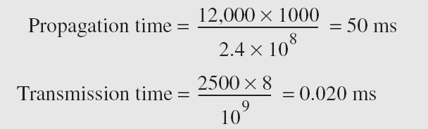
Example 1 - Transmission time
What are the propagation time and the transmission time for a 2.5-kbyte message (an e-mail) if the bandwidth of the network is 1 Gbps? Assume that the distance between the sender and the receiver is 12,000 km and that light travels at 2.4 × 10⁸ m/s.
Note : Message is short and the bandwidth is high so the dominant factor is the propagation time, not the transmission time. The transmission time can be ignored.

Slide 41



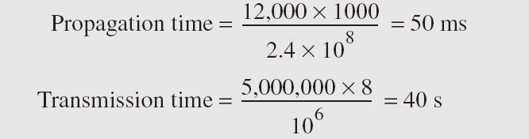
Example 2 - Transmission time
What are the propagation time and the transmission time for a 5-Mbyte message (an image) if the bandwidth of the network is 1 Mbps? Assume that the distance between the sender and the receiver is 12,000 km and that light travels at 2.4 × 10⁸ m/s.
Note: Message is very long and the bandwidth is not very high so the dominant factor is the
transmission time, not the propagation time. The propagation time can be ignored.

Slide 42


Latency – Queuing time
time needed for each intermediate or end device to hold the message before it can be processed.
not a fixed factor - changes with the load imposed on the network.
When there is heavy traffic on the network, the queuing time increases
An intermediate device, such as a router, queues the arrived messages and processes them one by one
If there are many messages, each message will have to wait

Slide 43

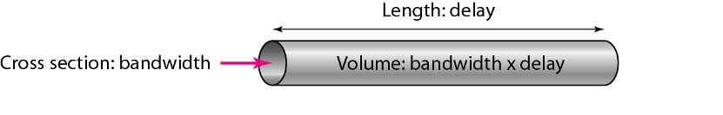
Bandwidth-Delay Product
The product of bandwidth and delay is the number of bits that can fill the link
two hypothetical cases as examples
Filling the links with bits
Filling the pipe with bits
Two cases show that product of bandwidth and delay is the number of bits that can fill the link

Slide 44
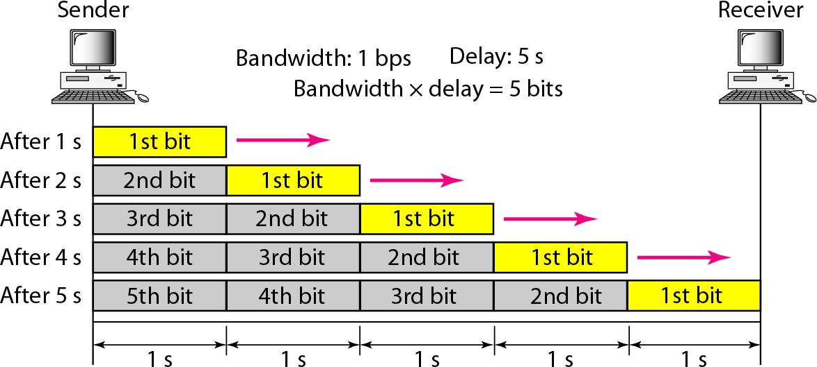
Bandwidth-Delay Product
Filling the links with bits
assuming that we have a link with a bandwidth of 1 bps (unrealistic).
We also assume that the delay of the link is 5 s (also unrealistic).
We want to see what the bandwidth-delay product means in this case?
This product 1 × 5 is the maximum number of bits that can fill the link.
There can be no more than 5 bits at any time on the link.

Slide 45
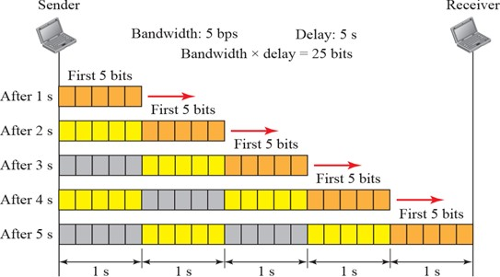
Bandwidth-Delay Product
Filling the pipe with bits
Assuming we have a bandwidth = 5 bps, and delay of the link = 5 s
There can be maximum 5 × 5 = 25 bits on the line.
The reason is that, at each second, there are 5 bits on the line
The duration of each bit is: 1/5 = 0.20 s.

Slide 46
Bandwidth-Delay Product
The number of bits that can fill the link is important if we need to send data in bursts and wait for the acknowledgment of each burst before sending the next one
To use the maximum capability of the link, we need to make the size of our burst 2 times the product of bandwidth and delay
sender should send a burst of data of (2 × bandwidth × delay) bits
sender then waits for receiver acknowledgment for part of the burst before sending another burst
amount 2 × bandwidth × delay is the number of bits that can be in
transition at any time

Slide 47

Jitter
Related to delay is jitter
Jitter is a problem if different packets of data encounter different delays and the application using the data at the receiver site is time-sensitive (audio and video data, for example)
If the delay for the first packet is 20 ms, for the second is 45 ms, and for the third is 40 ms, then the real-time application that uses the packets endures jitter.

Slide 48

Summary
Signals get impaired by attenuation, distortion, and noise
For a noiseless channel, the Nyquist bit rate formula defines the theoretical
maximum bit rate.
For a noisy channel, we need to use the Shannon capacity to find the
maximum bit rate.
Attenuation, distortion, and noise can impair a signal.
Attenuation is the loss of a signal’s energy due to the resistance of the
medium.
Distortion is the alteration of a signal due to the differing propagation
speeds of each of the frequencies that make up a signal.
Noise is the external energy that corrupts a signal.
The bandwidth-delay product defines the number of bits that can fill the link.

Slide 49

Homeworks
Solve the chapter 3 problems: P3-15 to P3-33

